Slide 1
TOPOLOGICAL DATA ANALYSIS
LE QUANG MINH

Slide 2
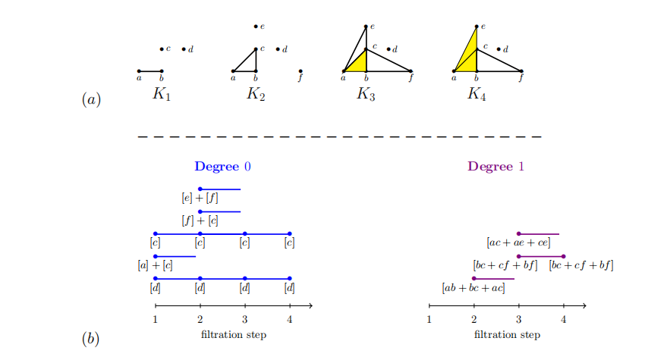
PH

Slide 3
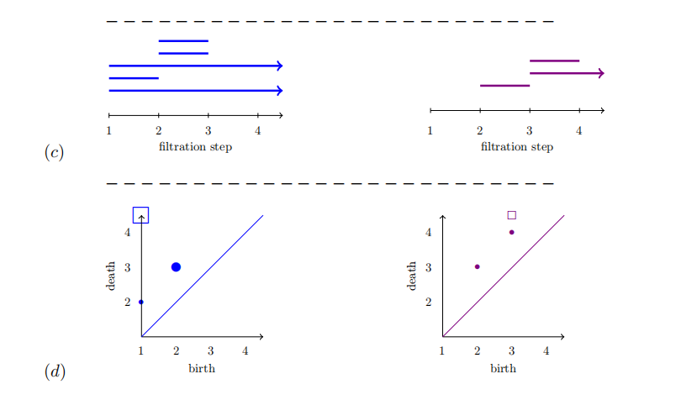
PH

Slide 4
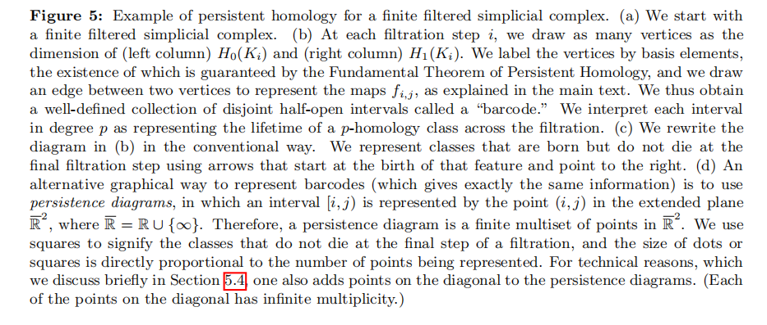
PH

Slide 5
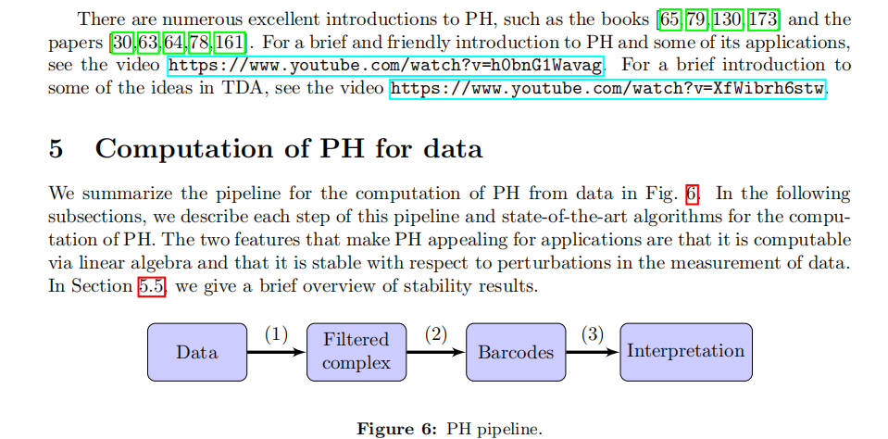
PH

Slide 6
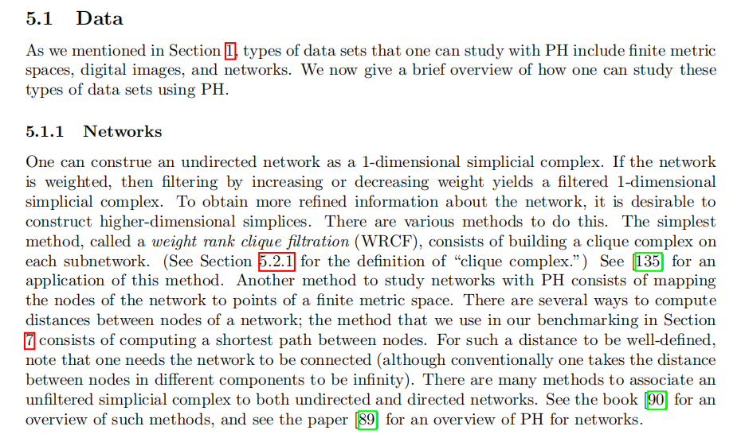
PH

Slide 7
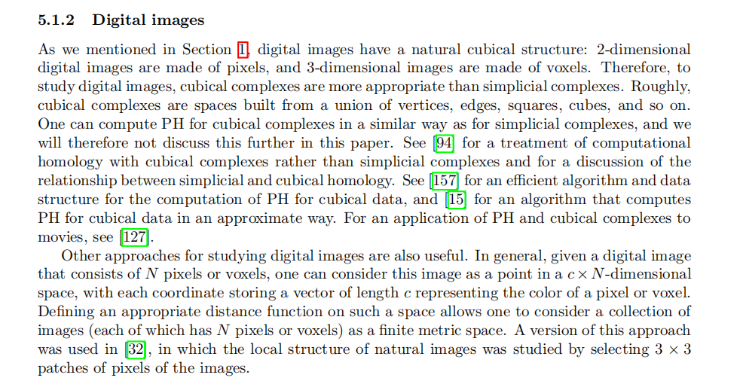
PH

Slide 8
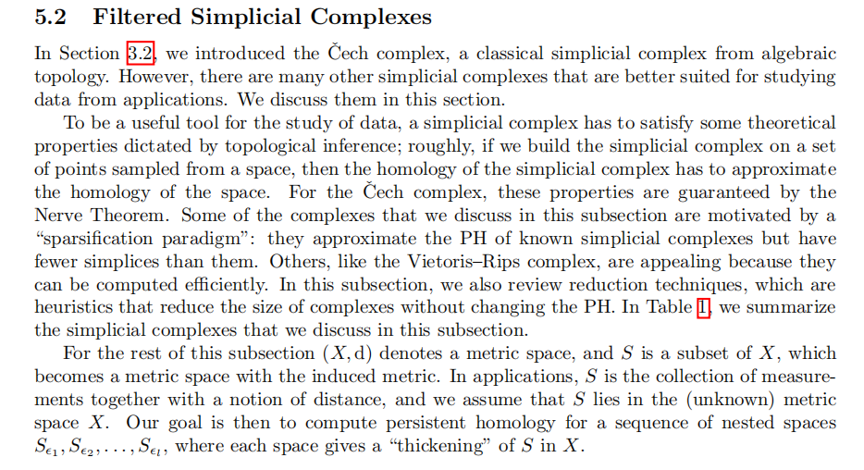
PH

Slide 9
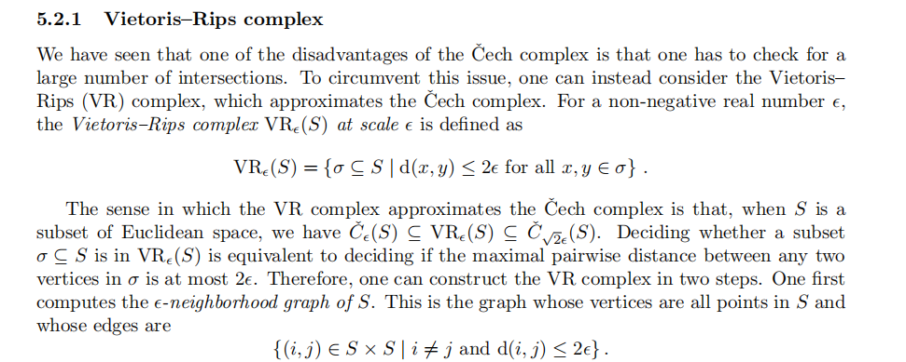
PH

Slide 10

PH

Slide 11
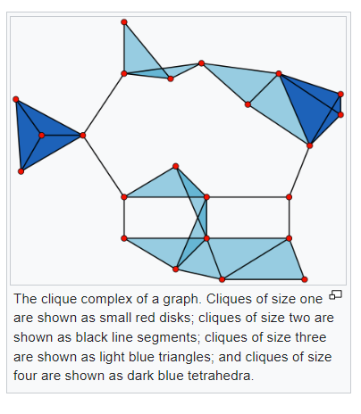
EXAMPLE CLIQUE COMPLEX

Slide 12
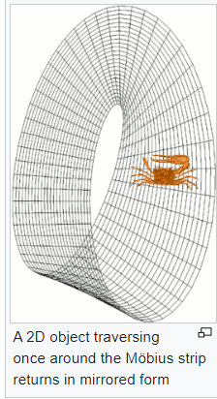
MOBIUS STRIP

Slide 13
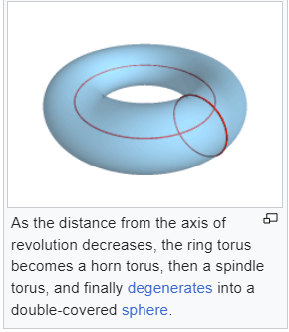
TORUS

Slide 14
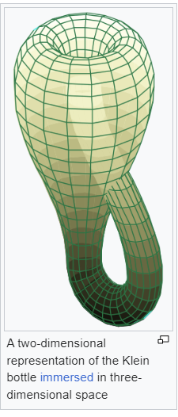
KLEIN BOTTLE

Slide 16
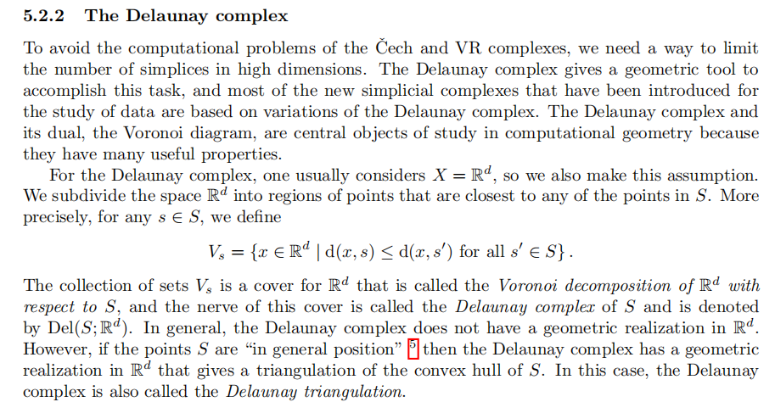
PH

Slide 17

PH

Slide 18

PH

Slide 19
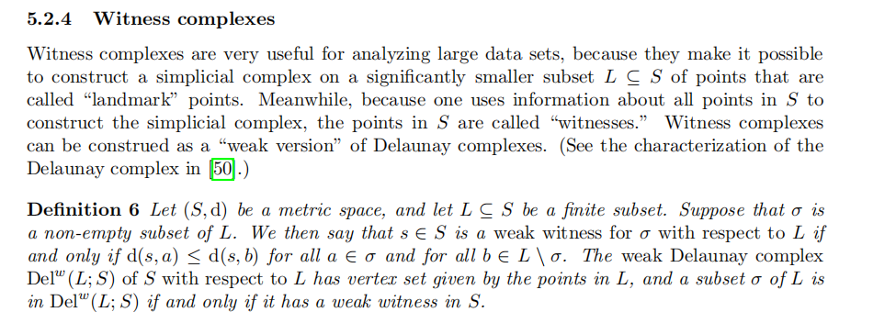
PH

Slide 20

PH

Slide 21

PH

Slide 22

PH

Slide 23
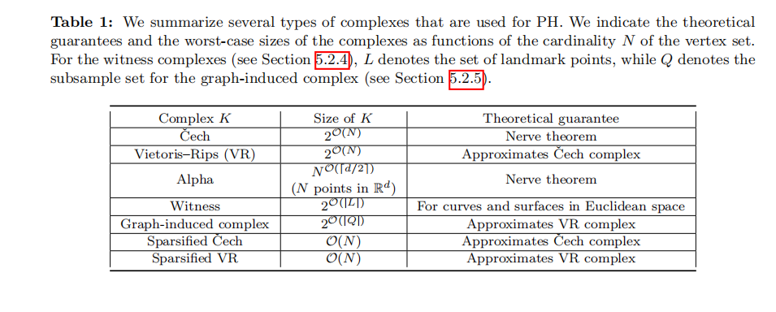
PH

Slide 24
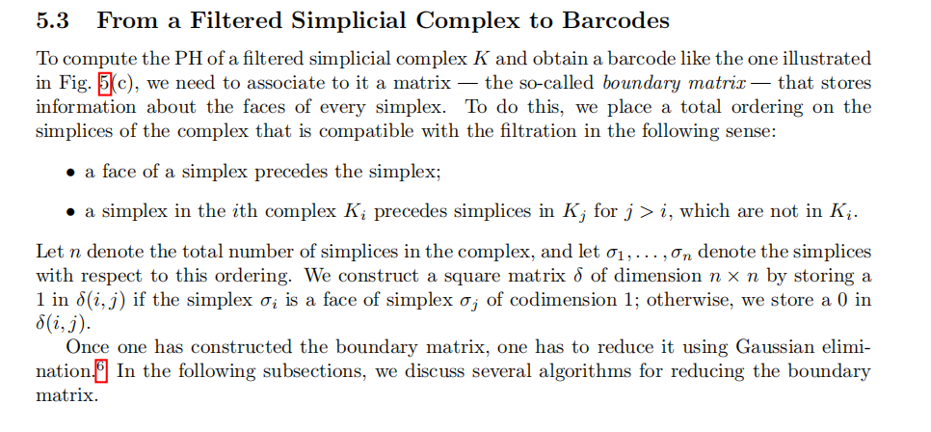
PH

Slide 25

PH

Slide 26
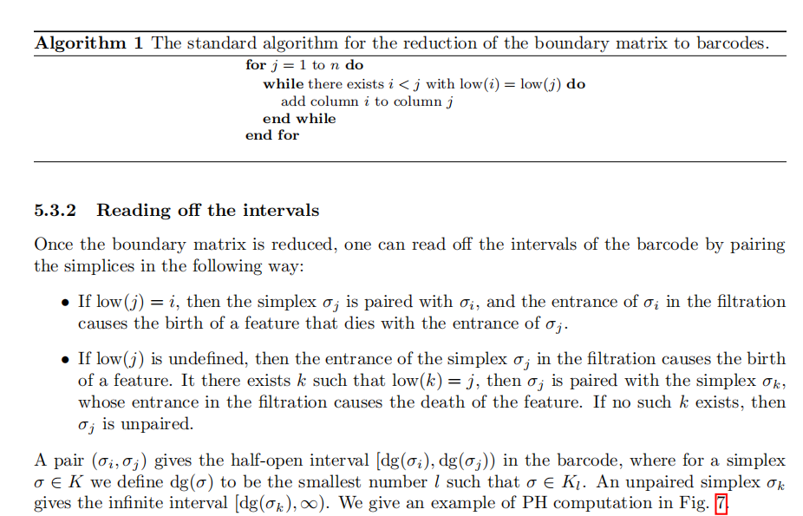
PH

Slide 27
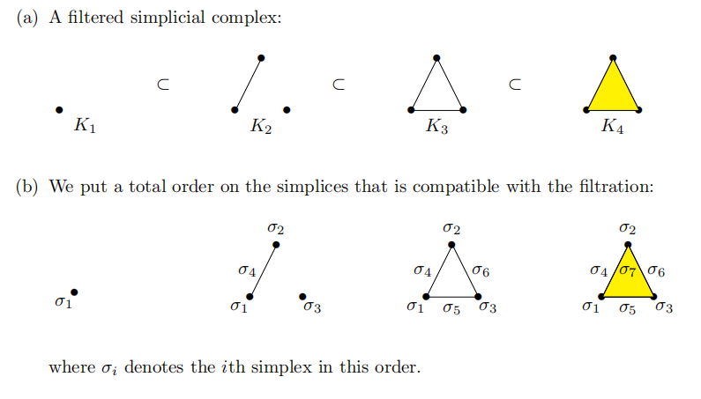
PH

Slide 28
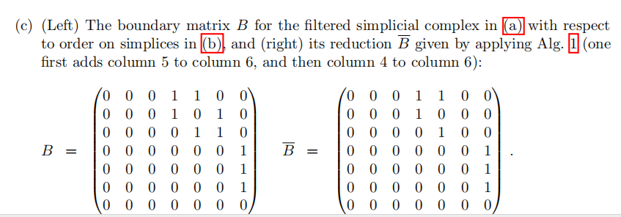
PH

Slide 29

PH

Slide 30
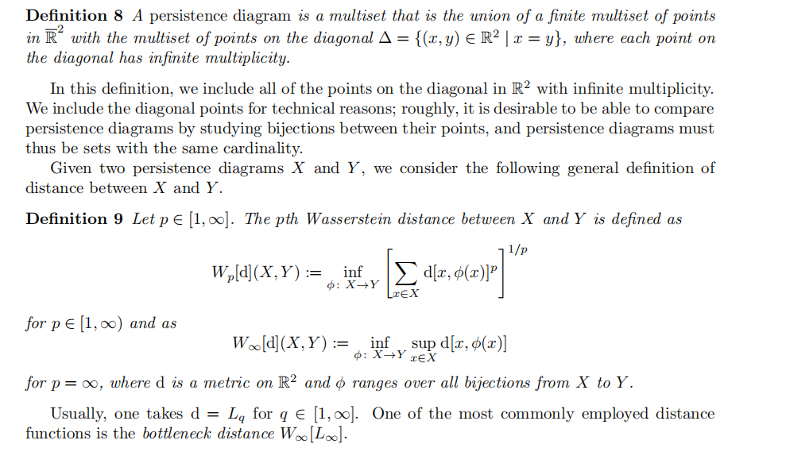
PH

